Slide 1



Slide 2
Quick recap:
What is an MCU? How does it work?
How to use the Arduino IDE
Serial communication
I2C communication
Installing libraries
Getting angle reading from accelerometer

Slide 3
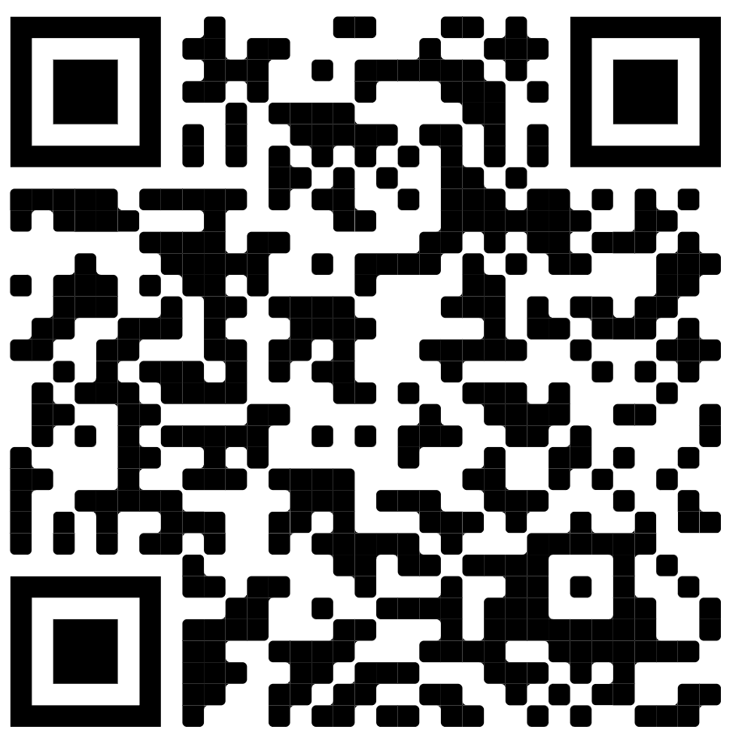
Follow us on Instagram!

Slide 4
What will be covered today?
Motor driver (L298N) board
Arduino inputs and outputs
Coding practices and structuring your program
Control systems basics
Interrupts

Slide 5
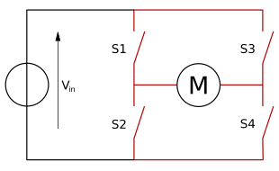
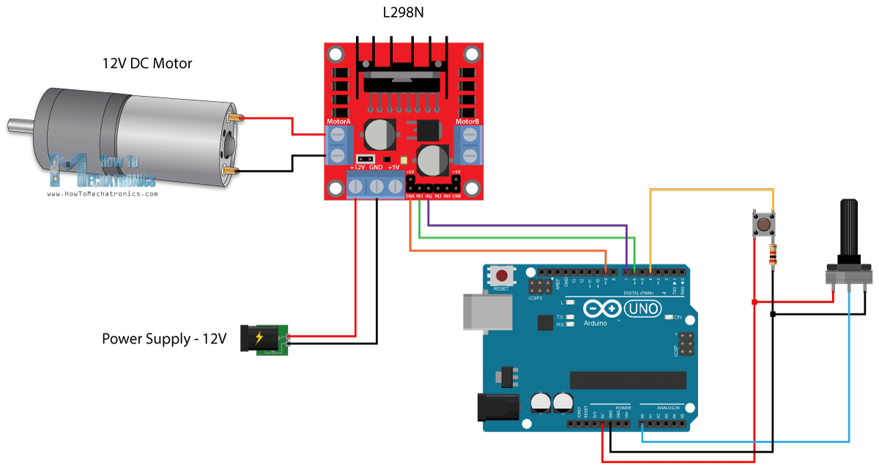
The motor driver
As the name suggests: it drives the motors!
H bridge architecture ->
Two inputs:
  Motor direction (2 digital pins)
  Motor voltage (1 analog pin)
Two outputs
Power ground must be connected to Arduino ground!

Slide 6
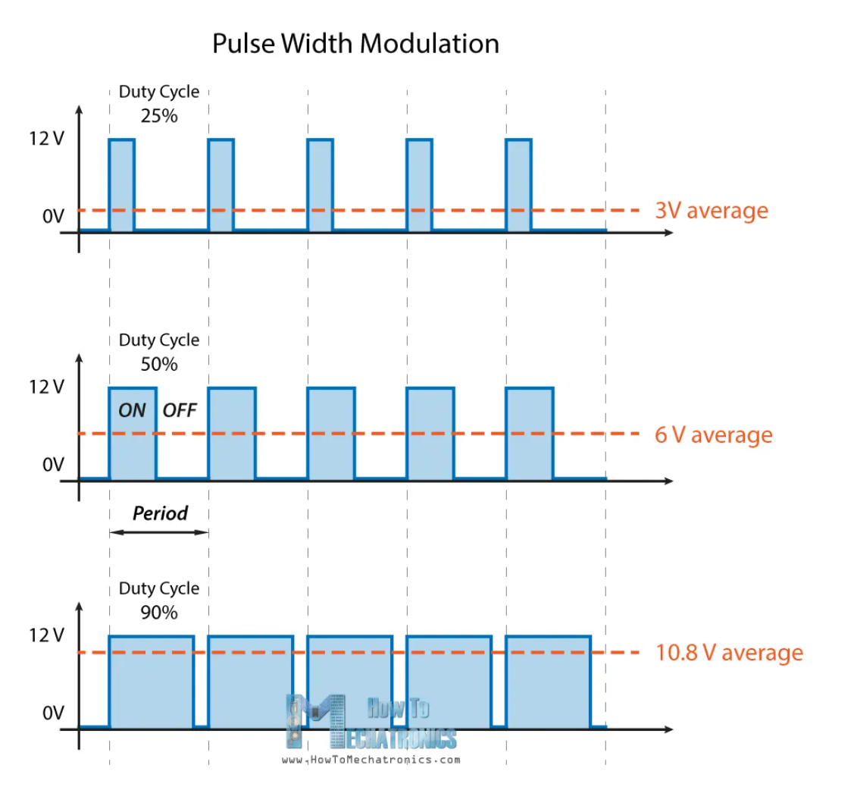
Arduino inputs/outputs
Two kinds of outputs:
  Digital (HIGH/LOW)
  Analog (PWM from 0 to 255)
Two kinds of inputs
  Digital (HIGH/LOW)
  Analog (0 to 5 V encoded as 0 to 1023)
Notes:
Do a code demonstration of inputs and outputs

Slide 7
Coding practices/conventions + tips
No one “right” formatting for code but general rules I suggest to follow:
  Clear and MENINGFUL variable and function names
  As few global variables as possible
  Add comments where necessary (but don’t overdo it)
  Don’t put everything in the loop, write functions instead!
  Delay() might mess with timings, try and avoid
  Draw flowcharts or write pseudocode before writing the actual code
  Be consistent with your style

Slide 8
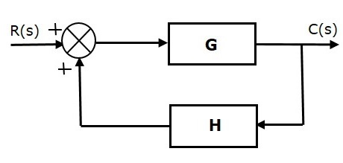
Basics of control systems
Basically, how output changes based on the input
Open loop – set some value and hope for the best
Closed loop:
  Measure the angle
  Decide what the motor speed should be based on the difference between measured and target angle

Slide 9
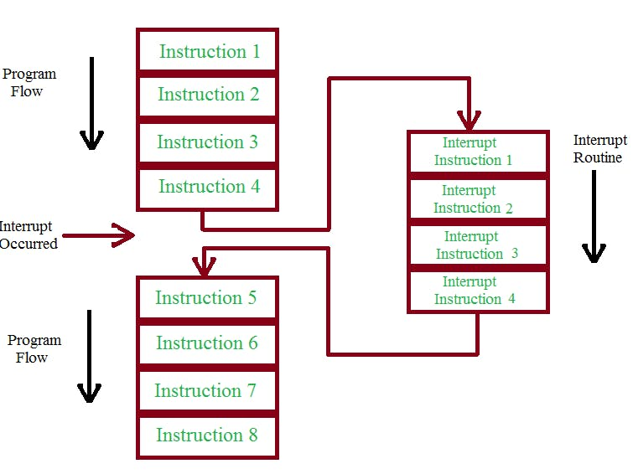
Interrupts
We can configure external (button press) or internal (timer) events to trigger an interrupt
The interrupt will pause program, execute interrupt service routine once, and continue running the program
We don’t want to be doing anything that takes
  Much time during the interrupt

Slide 10
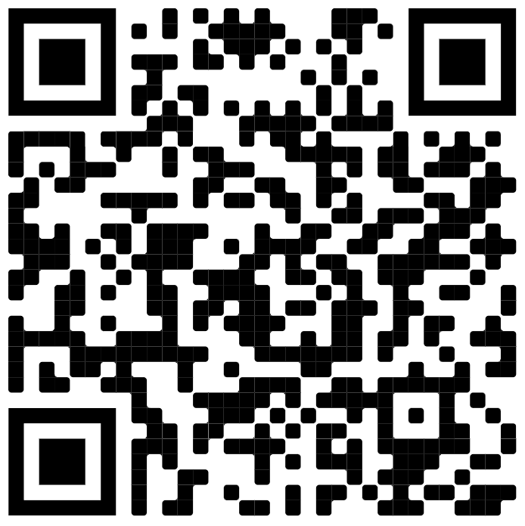
Some helpful stuff, hopefully:

